Slide 1
SQL SERVER 2008 r2
Setting Up Database server , and Analysis Server
SQL Server 2008 : please get full version of SQl server 2008 since only full version contains what we need for the project
You can download the full version for free with the help of the following Youtube video:
https://www.youtube.com/watch?v=KaImalZWEVg

Slide 2
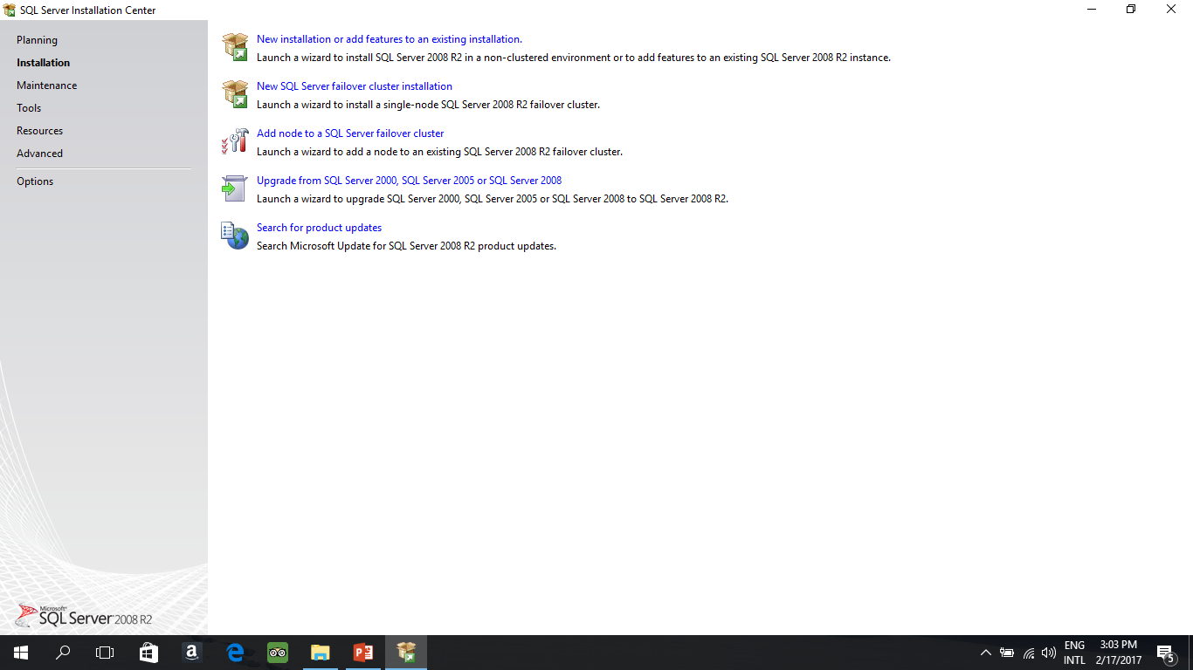
Setting Up Database Server :Step 1
Run the Setup.exe Please Follow the Steps One by one .

Slide 3
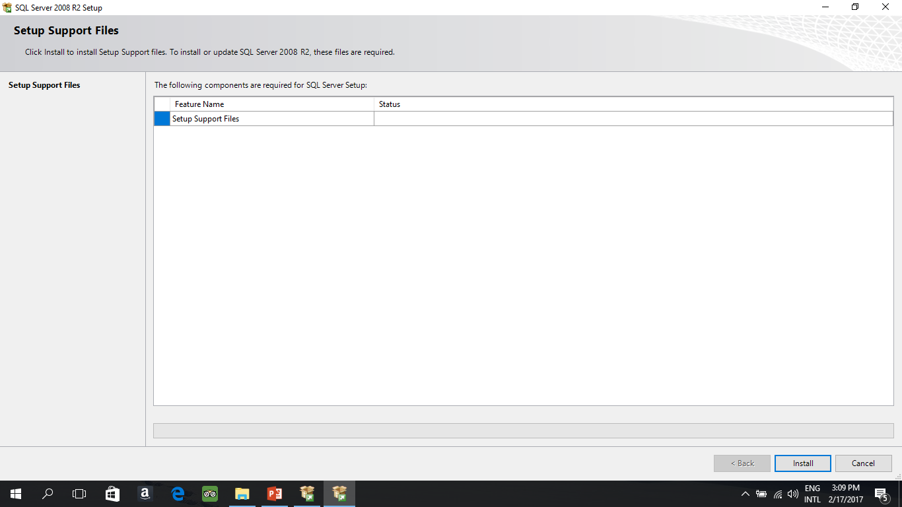
Step 2 :After step 1, it will run compatibility check then click ok.

Slide 4
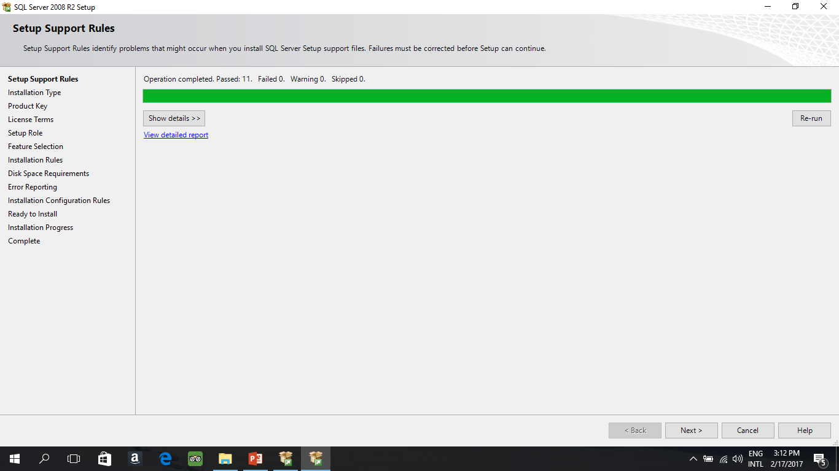
Step 3

Slide 5
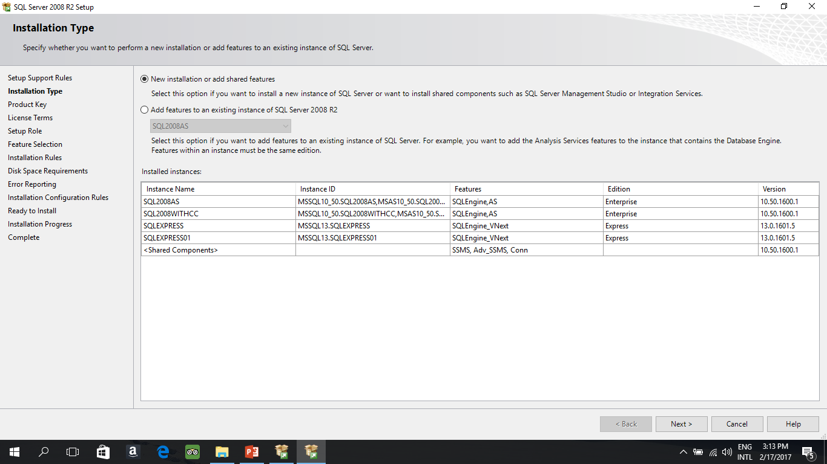
Step 4
These are my instances means “Servers” if its first time using sql server then list should be empty

Slide 6
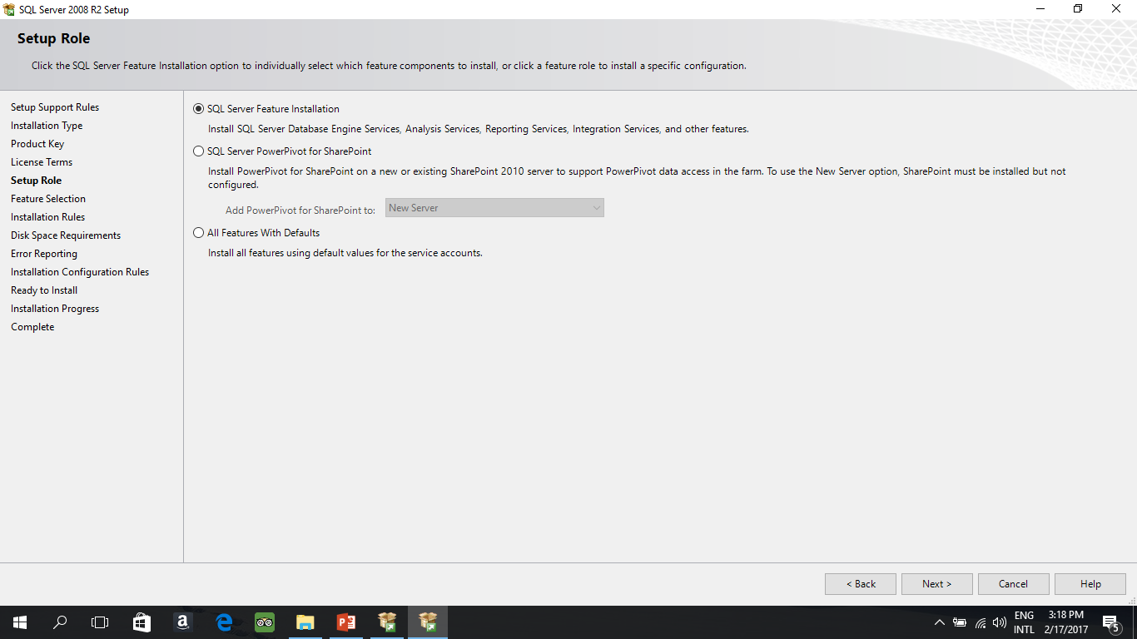
Enter the Activation key then : Step 5

Slide 7
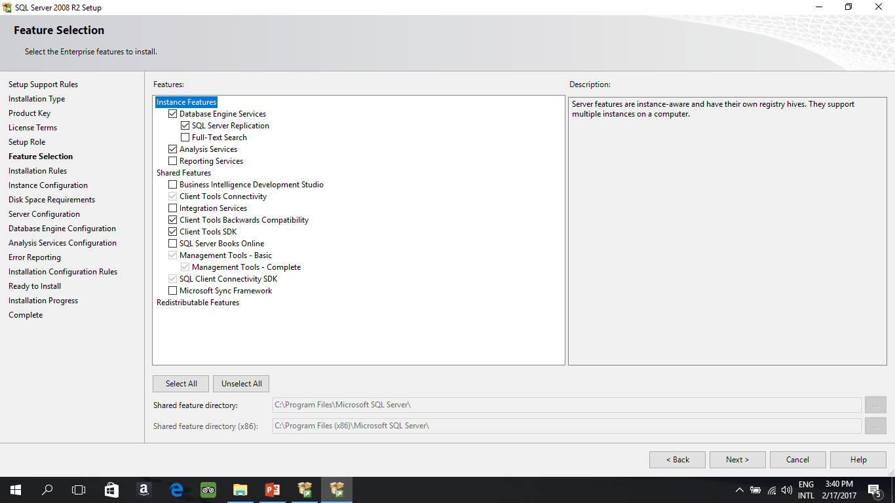
Step 6: Make sure you select the pointed options
Here is the analysis service

Slide 8
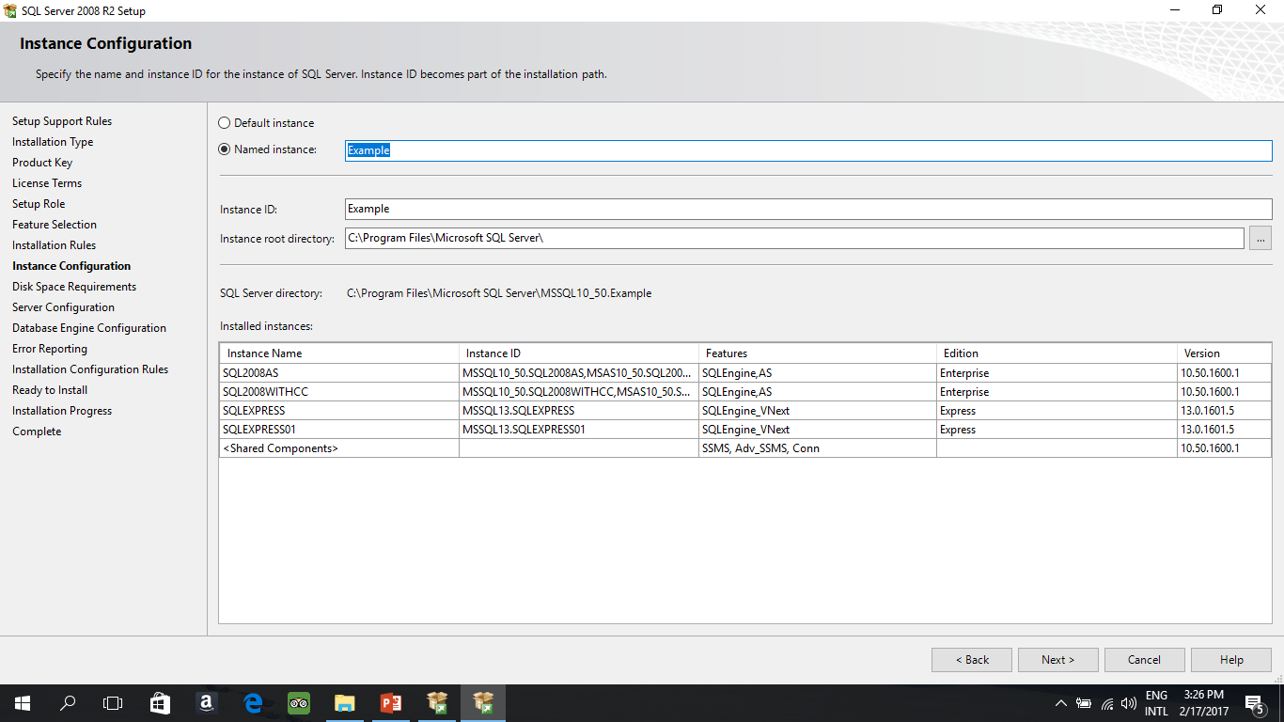
Step 7 : name your instance and don’t forget it

Slide 9
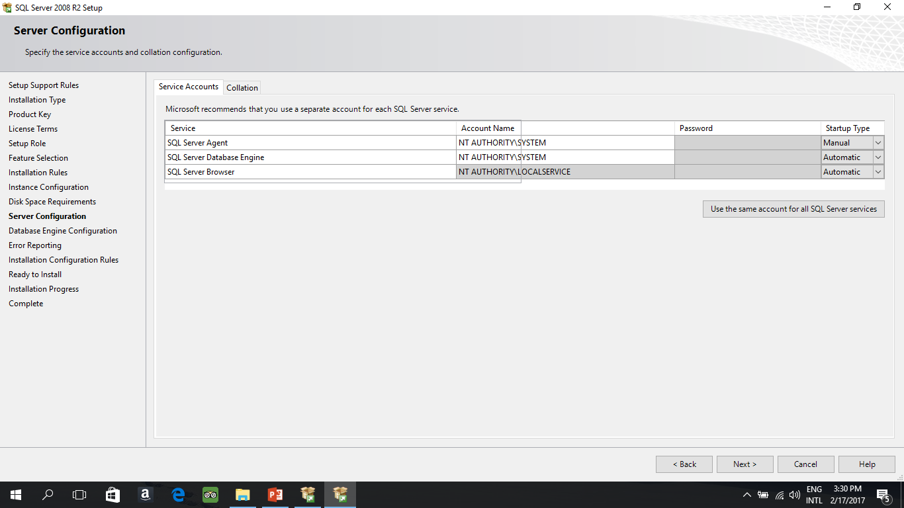
Step 9 :before step 9 it will check Diskspace

Slide 10
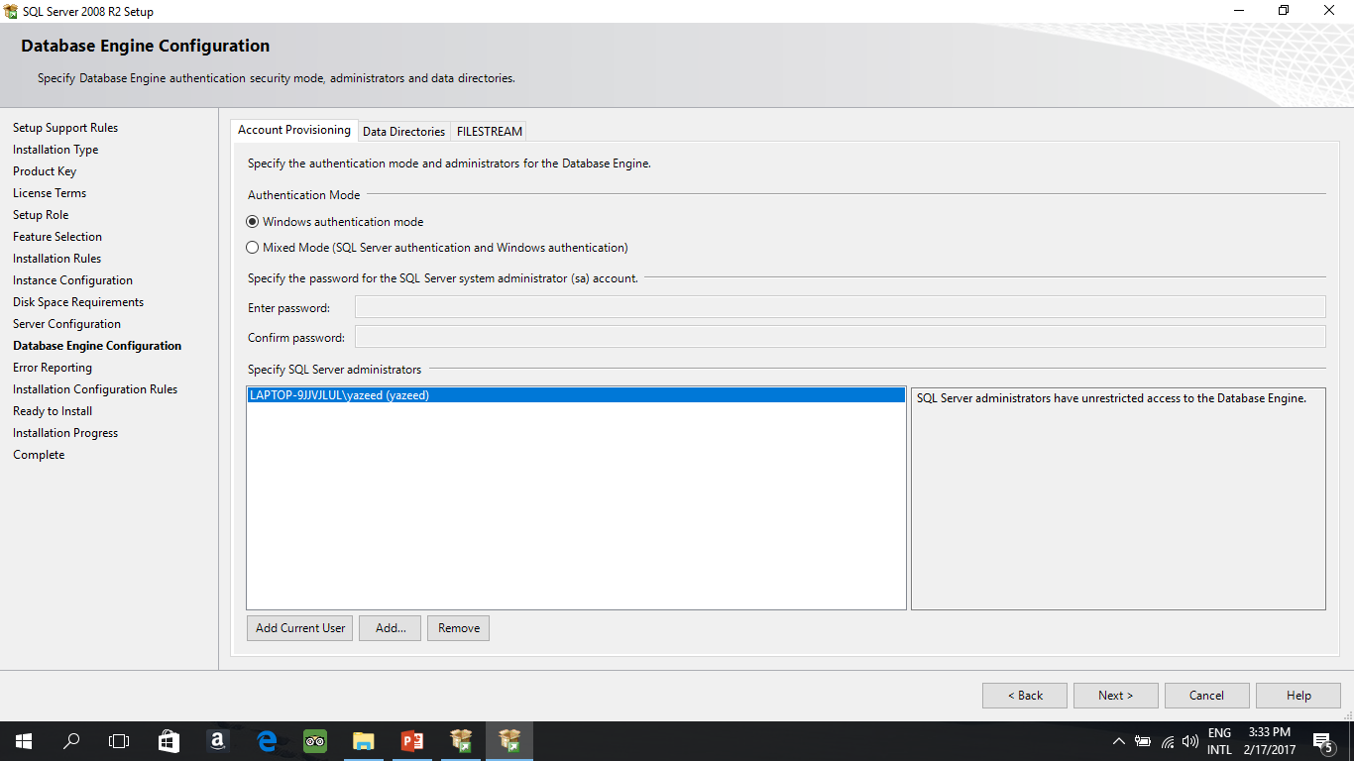
Step 10 : Click on Add Current User

Slide 11
Step 10 : Click next until installation starts
Once the installation is done, your database is will be ready.
Now download and install the SQL Data Tools from the following website:
https://www.microsoft.com/en-sa/download/details.aspx?id=42313

